Slide 1
OSI (Open Systems Interconnect)
Reference Model
1

Slide 2
OSI Model
OSI was developed by the International Organization for Standardization (ISO) and introduced in 1984.
It is a layered architecture (consists of seven layers).
Each layer defines a set of functions which takes part in data communication.
2

Slide 3
OSI Model Layers
Layer - 7
Application
User support Layers
or
Software Layers
Layer - 6
Presentation
Layer - 5
Session
Layer - 4
Transport
Core layer of the OSI
Layer - 3
Network
Network support Layers
or
Hardware Layers
Layer - 2
Data Link
Layer - 1
Physical
3

Slide 4
Application Layer
Application
Application Layer is responsible for providing an interface for the users to interact with application services or Networking Services .
Ex: Web browser, Telnet etc.
Application
Presentation
Session
Transport
Network
Data Link
Physical
4

Slide 5
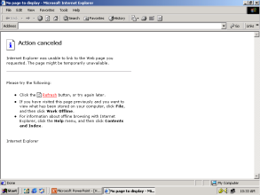
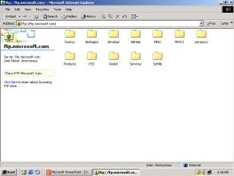
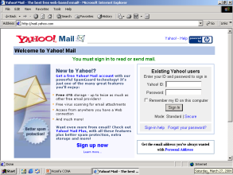
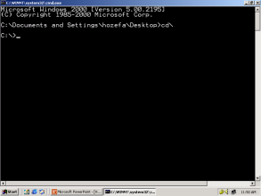
Examples of Networking Services
Service Port No.
HTTP 80
FTP 21
SMTP 25
TELNET 23
TFTP 69
5

Slide 6
Data flow from Application Layer
Application
Data
80
21
25
53
67
69
Presentation
Session
Transport
Network
Data Link
Physical
6

Slide 7
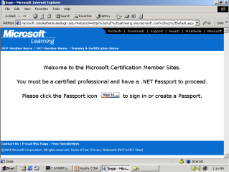
Presentation Layer
Application
Presentation Layer It is responsible for defining a standard format to the data.
It deals with data presentation.
The major functions described at this layer are..
Encoding – Decoding
Ex: ASCII, EBCDIC (Text)
JPEG,GIF,TIFF (Graphics)
MIDI,WAV (Voice)
MPEG,DAT,AVI (Video)
Encryption – Decryption
Compression – Decompression
Presentation
Presentation
Session
Transport
Network
Data Link
Physical
7

Slide 8
Data flow from Presentation Layer
Application
Data
Presentation
Data
Session
Transport
Network
Data Link
Physical
8

Slide 9
Session Layer
Application
Session Layer
It is responsible for establishing, maintaining and terminating the sessions.
Session ID is used to identify a session or interaction.
Examples :
RPC → Remote Procedural Call
SQL → Structured Query Language
ASP → AppleTalk Session protocol
Presentation
Session
Session
Transport
Network
Data Link
Physical
9

Slide 10
Data flow from Session Layer
Application
Data
Presentation
Data
Session
Data
Transport
Network
Data Link
Physical
10

Slide 11
Transport Layer
Application
Transport Layer
It provides data delivery mechanism between the applications in the network.
The major functions described at the Transport Layer are..
Identifying Service
Multiplexing & De-multiplexing
Segmentation
Sequencing & Reassembling
Error Correction
Flow Control
Presentation
Session
Transport
Transport
Network
Data Link
Physical
11
Notes:
Transport Layer provides data delivery mechanism between the applications in the network

Slide 12
Identifying a Service
Identification of Services is done using
Port Numbers.
Port is a logical communication Channel
Total No. Ports 0 – 65535
Server Ports 1 - 1023
Client Ports 1024 – 65535
12

Slide 13
Transport Layer Protocols
The protocols which takes care of Data Transportation
at Transport layer are…TCP,UDP
TCP
UDP
Transmission Control Protocol
Connection Oriented
Supports Ack’s
Reliable communication
Slower data Transportation
Protocol No is 6
Eg: HTTP, FTP, SMTP
User Datagram
Protocol
Connection Less
No support for Ack’s
Unreliable communication
Faster data Transportation
Protocol No is 17
Eg: DNS, DHCP, TFTP
13

Slide 14
Multiplexing & De-multiplexing
Multiplexing & De-multiplexing
Application
Presentation
Session
80
21
25
53
67
69
Transport
TCP - 6
UDP - 17
Network
Data Link
Physical
14

Slide 15

Sequencing & Reassembling
Segmentation
Hello! How are you ?
you Hello! How ? are
Hello! How are you ?
You Hello! How ? Are
You
Hello!
How
?
Are
Hello!
How
Are
You
?
A
B
15

Slide 16
Sequencing & Reassembling
Sequencing & Reassembling
Hello! How are you ?
Hello! How are you ?
Hello! How are you ?
Hello! How are you ?
Hello!
1/5
Hello!
1/5
Are
3/5
Are
3/5
You
4/5
You
4/5
?
5/5
How
2/5
?
5/5
How
2/5
You
4/5
Hello!
1/5
How
2/5
?
5/5
Are
3/5
A
B
16

Slide 17
Error Correction
Error Correction
Hello! How are you ?
Segment Missing
Hello! How are you ?
Hello! How are you ?
Hello! How are you ?
Hello!
1/5
Hello!
1/5
Are
3/5
Are
3/5
You
4/5
You
4/5
?
5/5
Hello!
1/5
How
2/5
Are
3/5
You
4/5
?
5/5
How
2/5
?
5/5
You
4/5
Hello!
1/5
How
2/5
?
5/5
Are
3/5
A
B
17

Slide 18
Flow Control
Flow Control
Window Size = 1
Send 1
Receive 1
Ack 2
Send 2
Receive 2
Ack 3
Window Size = 3
Send 3
Receive 3
Send 4
Receive 4
Send 5
Receive 5
Ack 6
Send 7
A
B
18

Slide 19
Error Correction
A
B
1 2 3 4 5 6 7
1 2 3 4 5 6 7
Send 1
Send 2
Send 3
Ack 4
Send 4
Send 5
Send 6
Ack 5
Send 5
Ack 7
19

Slide 20
Data flow from Transport Layer
Application
Data
Presentation
Data
Session
Data
Transport
Segment
TH
Data
Network
Data Link
Physical
20

Slide 21
Network Layer
Application
Network Layer
It provides Logical addressing & Path determination (Routing) in this layer.
The protocols that work in this layer are:
Routed Protocols:
IP, IPX, AppleTalk.. Etc
Routed protocols used to carry user data between hosts.
Routing Protocols:
RIP, OSPF.. Etc
Routing protocols performs Path determination (Routing).
Presentation
Session
Transport
Network
Network
Data Link
Physical
21

Slide 22
Routed Protocols
Segment
Transport
S.IP: 10.0.0.1
D.IP:10.0.0.2
S.IP: 10.0.0.1
D.IP:10.0.0.2
Network
Segment
A
B
10.0.0.1
10.0.0.2
22

Slide 23
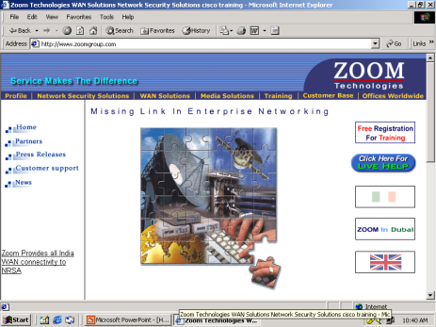
Routing Protocols
www.zoomgroup.com
A
23

Slide 24
Data flow from Network Layer
Application
Data
Presentation
Data
Session
Data
Devices that work at Network Layer
are Router, Multilayer switch etc..
Transport
Segment
Network
Packet
NH
Segment
Data Link
Physical
24

Slide 25
Datalink Layer
Datalink Layer
It has 2 sub layers
MAC (Media Access Control) It provides reliable transit of data across a physical link.
It also provides ERROR DETECTION using CRC (Cyclic Redundancy Check) and ordered delivery of Frames.
Ex: Ethernet, Token ring…etc
LLC (Logical Link Control)
It provides communication with Network layer.
Negotiates with Network Layer using SAP & SNAP protocols
Application
Presentation
Session
Transport
Network
Data Link
Data Link
Physical
25

Slide 26
Error Detection – CRC Check
PC-A
CRC No. 33333
PC-B
CRC No. 11114
Error Detected
For Error Correction
Contact Source Transport layer
Packet
Hello! How are you ?
Source MAC
00-20-18-C0-07-71
Destination MAC
00-20-18-C0-07-72
00000
32434
22222
89696
55434
99323
43434
99434
46323
11114
33333
00000
32434
22222
89696
55434
99323
43434
99434
46323
11114
Error Detected
Packet
A
B
192.168.1.1
00-20-18-C0-07-71
192.168.1.2
00-20-18-C0-07-72
26

Slide 27
Error Detection – CRC Check
Packet
Packet
Hello! How are you ?
Source MAC
00-20-18-C0-07-71
Destination MAC
00-20-18-C0-07-72
00000
32434
22222
89696
55434
99323
43434
99434
46323
11114
20202
00000
32434
22222
89696
55434
99323
43434
99434
46323
11114
20202
Source MAC
00-20-18-C0-07-71
Destination MAC
00-20-18-C0-07-72
Packet
A
B
192.168.1.1
00-20-18-C0-07-71
192.168.1.2
00-20-18-C0-07-72
27

Slide 28
Data flow from Data Link Layer
Application
Data
Presentation
Data
Session
Data
Transport
Segment
Devices that work at Data link layer are Switch, Bridge etc..
Network
Packet
Data Link
Frame
DH
Packet
Packet
DT
Physical
28

Slide 29
Physical Layer
Physical Layer
It defines the electrical, Mechanical &
functional specifications for communication between the Network devices.
The functions described at this layer are..
Encoding/decoding:
It is the process of converting the binary data
into signals based on the type of the media.
Copper media : Electrical signals of different voltages
Fiber media : Light pulses of different wavelengths
Wireless media: Radio frequency waves
Mode of transmision of signals:
Signal Communication happens in three different modes
Simplex, Half-duplex, Full-duplex
Protocols works at physical layer: 10BaseT, 100BaseT,
V.35, RS-232..etc
Application
Presentation
Session
Transport
Network
Data Link
Physical
Physical
29

Slide 30
Physical Transmission of data Example:
Frame
Frame
Hello! How are you ?
1010101010101010
1010101010101010
Frame
A
1010101101010101010101010
B
0101011010101010101010101
1010101101010101010101010
0101011010101010101010101
0101011010101010101010101
30

Slide 31
Data flow from Physical Layer
Application
Data
Presentation
Data
Session
Data
Transport
Segment
Network
Packet
Devices that work at
physical layer are ..
Hub, Repeater.. Etc
Data Link
Frame
Physical
Bits
31

Slide 32
Data Encapsulation & De-capsulation
A
B
Application
Data
Data
Application
Presentation
Data
Data
Presentation
Session
Data
Data
Session
Transport
Transport
Segment
Segment
TH
TH
Data
TH
Data
Network
Packet
Packet
Network
NH
Segment
NH
Segment
NH
Data Link
Packet
Data Link
Frame
DH
Frame
DH
Packet
Packet
Packet
DT
DT
DH
DT
Physical
Bits
Bits
Physical

Slide 33
Comparing OSI with TCP/IP Layers
OSI Layers
TCP/IP Layers
Application
Application
Presentation
Session
Transport
Host-to-Host
Network
Internet
Data Link
Network
Access
Physical
33

Slide 34
THE END
34

Slide 36
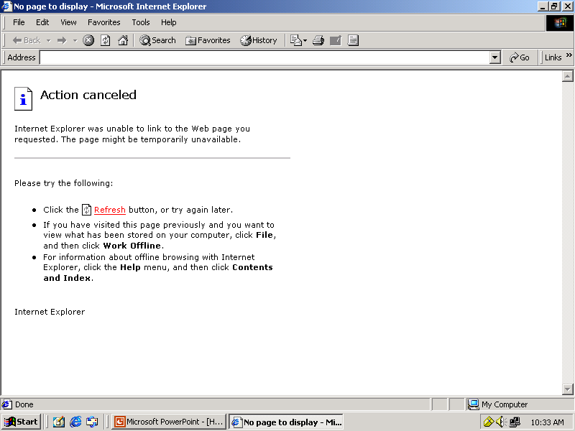
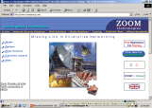
Example of HTTP request
http://www.zoomgroup.com
Client
Web Server

Slide 37
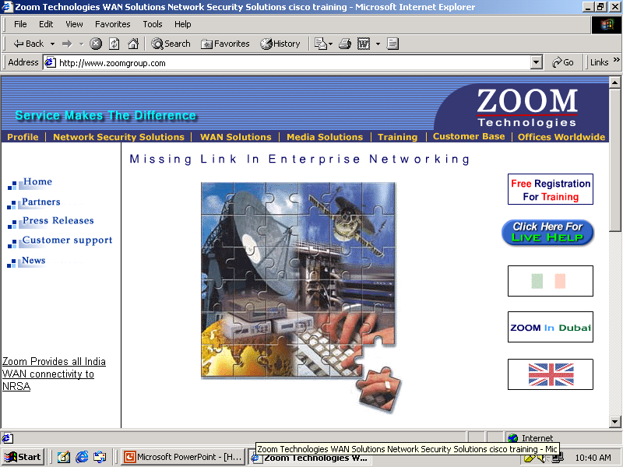
Example of HTTP request
HTTP Request
http:// www.zoomgroup.com
Webpage
HTTP Request
Listen on
Port 80
Sending HTTP Reply
Webpage
Received HTTP Reply
http://www.zoomgroup.com
Webpage
Client
Web Server

Slide 38
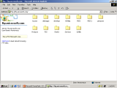
Example of FTP request
ftp://ftp.microsoft.com
Client
FTP Server

Slide 39

Example of FTP request
FTP Request
ftp://ftp.microsoft.com
FTP Request
Listen on
Port 21
Sending FTP Reply
Received FTP Reply
ftp://ftp.microsoft.com
Client
FTP Server

Slide 40
ftp://ftp.microsoft.com

Slide 41
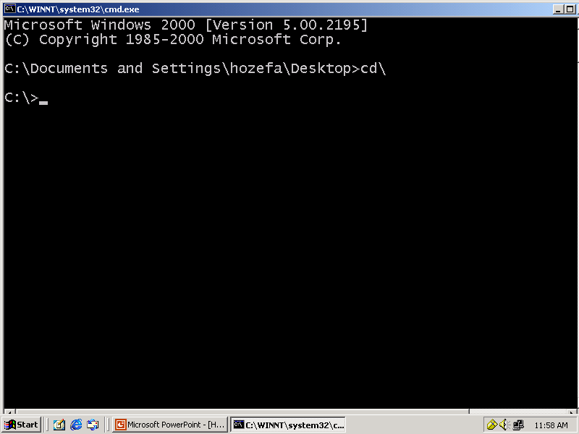
Microsoft Windows 2000 [Version 5.00.2195]
(C) Copyright 1985-2000 Microsoft Corp.
C:\>
telnet 192.168.1.150
Connecting
.....
================================
Welcome to Hyderabad Router
================================
User Access Verification
password :

Slide 42
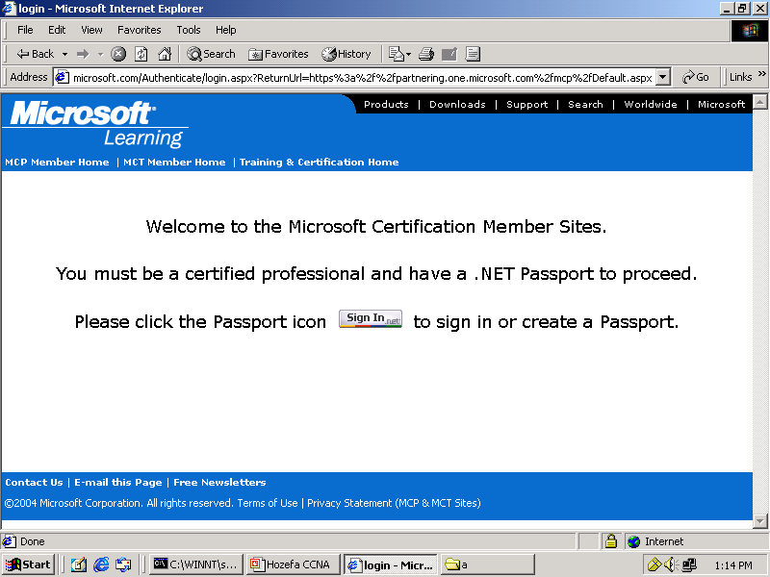
http://www.microsoft.com

Slide 43
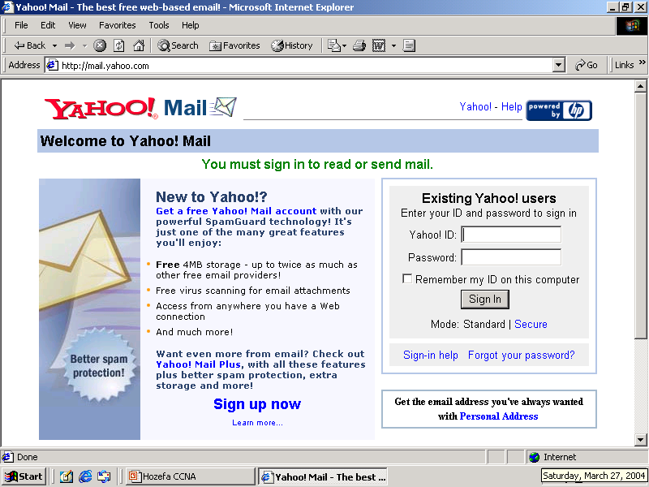
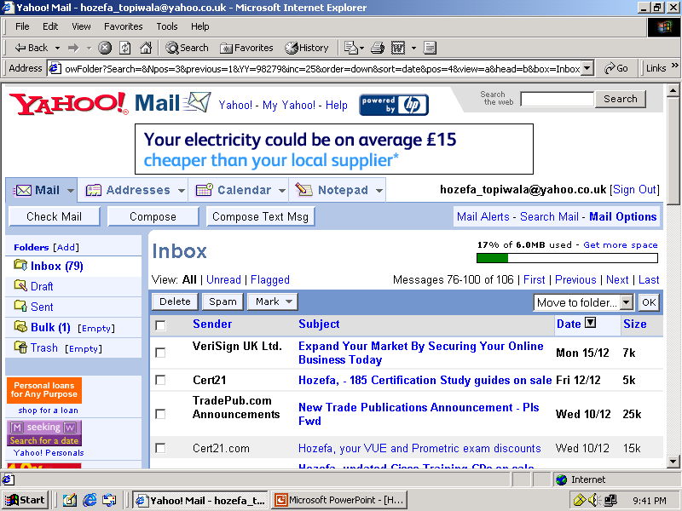
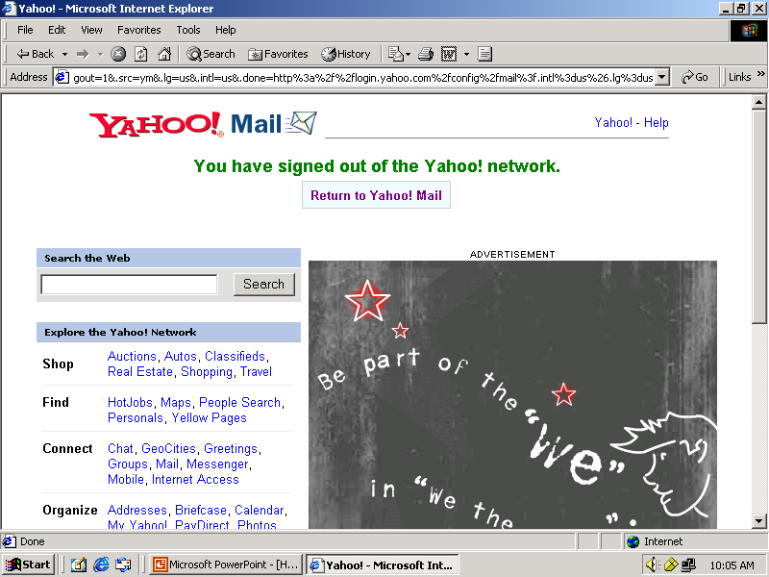
http://mail.yahoo.com
xyz@yahoo.com
xyz
******

